Slide 1
Project Name:
Exam System

Slide 2
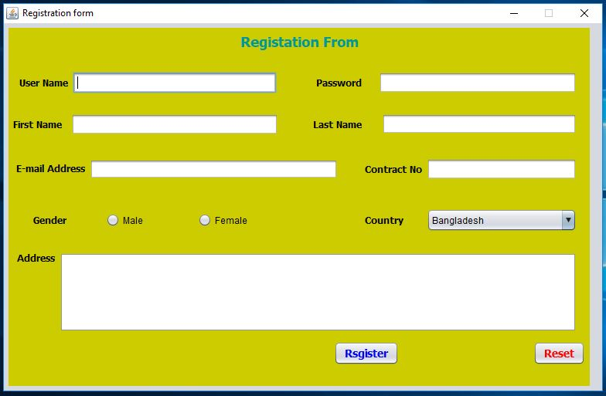
Registration From

Slide 3
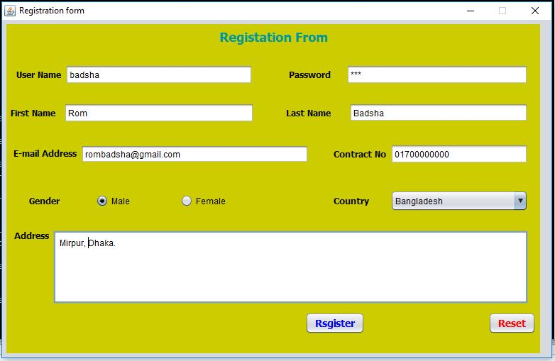
Fill Up Registration From

Slide 4
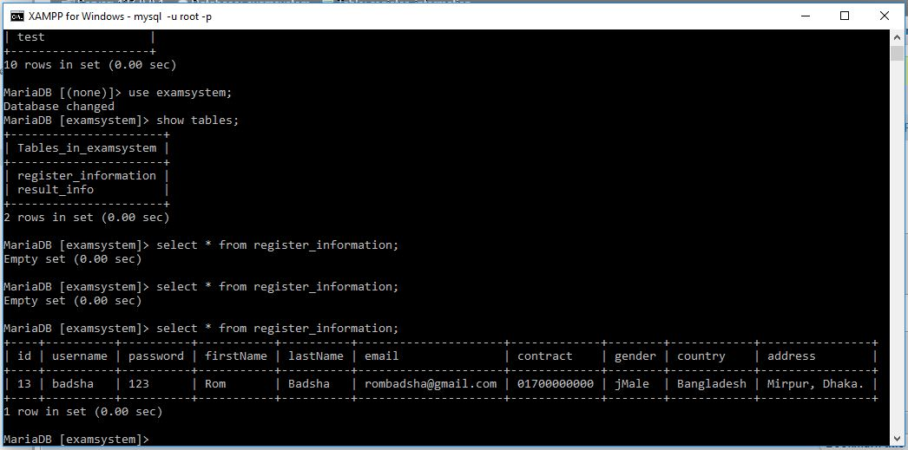
Data Storage in the Database

Slide 5
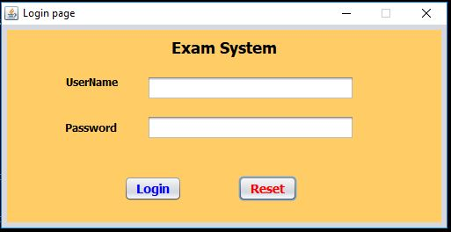
Login

Slide 6
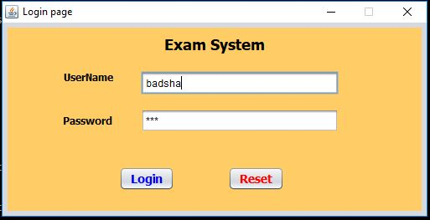
Insert
UserName
and
Password

Slide 7
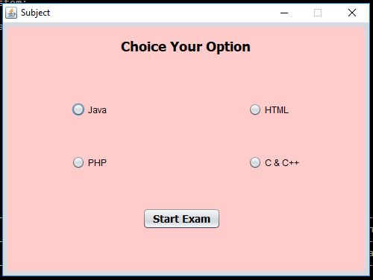
choose the
subject in the
examination

Slide 8
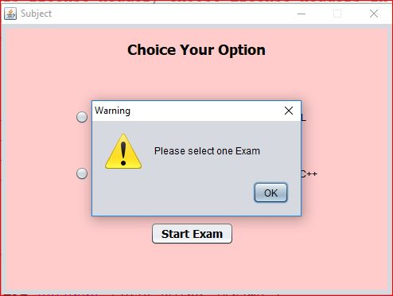
Warning Message

Slide 9
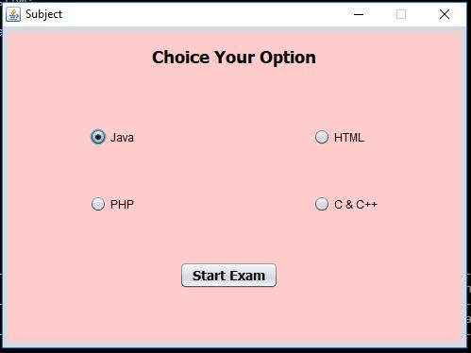
choose the
subject in the
examination

Slide 10
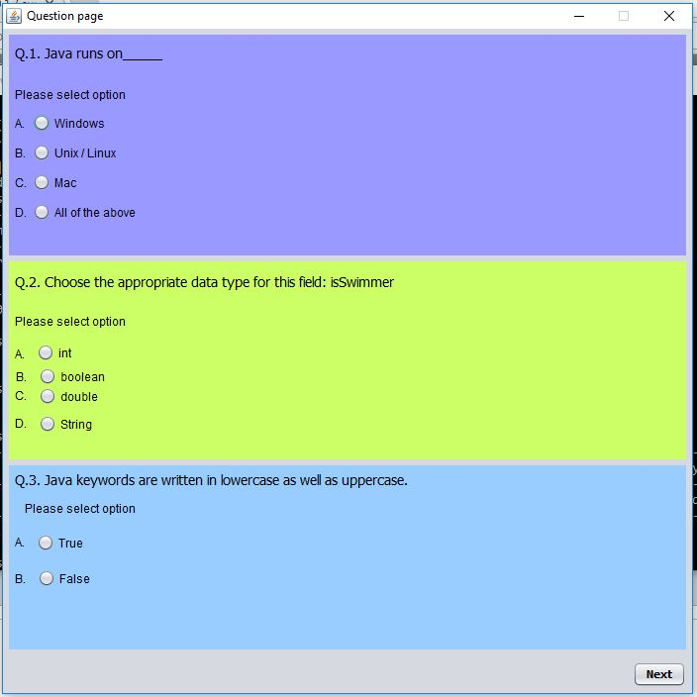
Answer the Questions

Slide 11
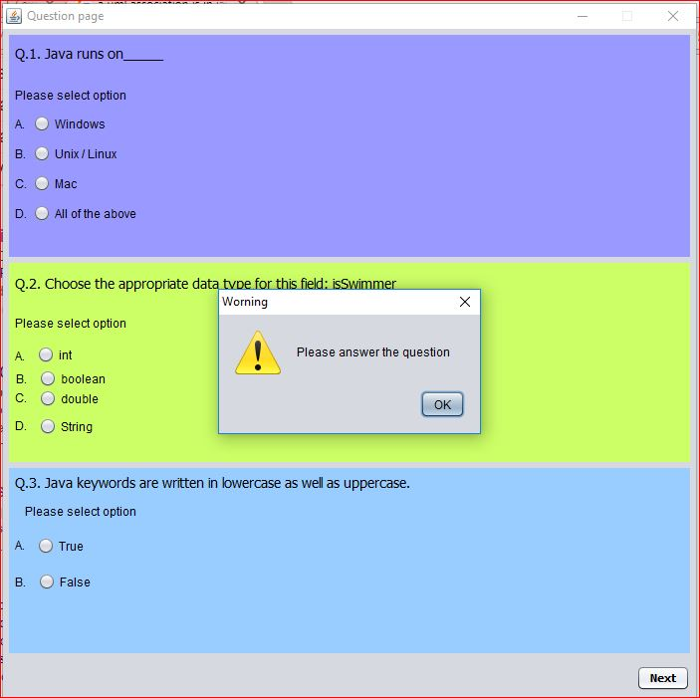
Warning Message

Slide 12
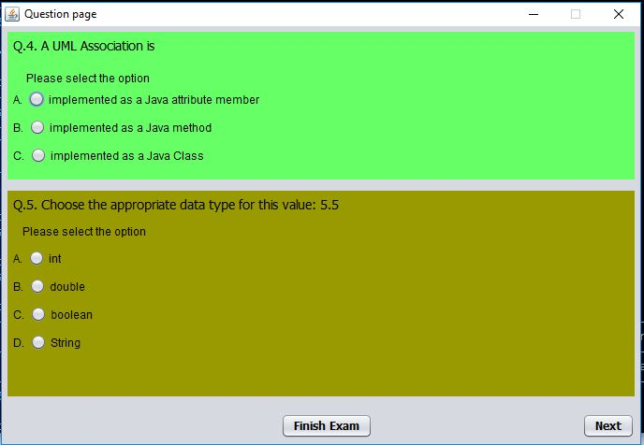
Answer the Questions

Slide 13
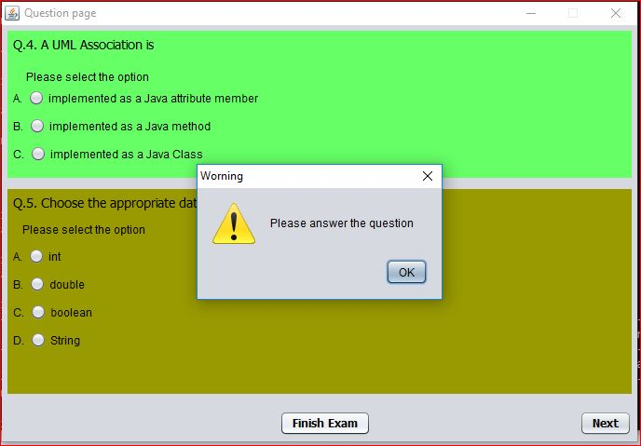
Warning Message

Slide 14
THANK YOU

